Slide 1















Development of a Custom CNN Using Deep Learning
and TensorFlow for Fire Detection
Presented
Chandan Jain

Slide 2
⬥ Introduction
⬥ Objective
⬥ Problem Statement
⬥ Solution Overview
⬥Literature Survey
⬥Comparative Analysis of Existing Works
⬥Proposed Approach
⬥Project Design
⬥Results
⬥Conclusion
⬥ Future Plan
⬥References

Slide 3
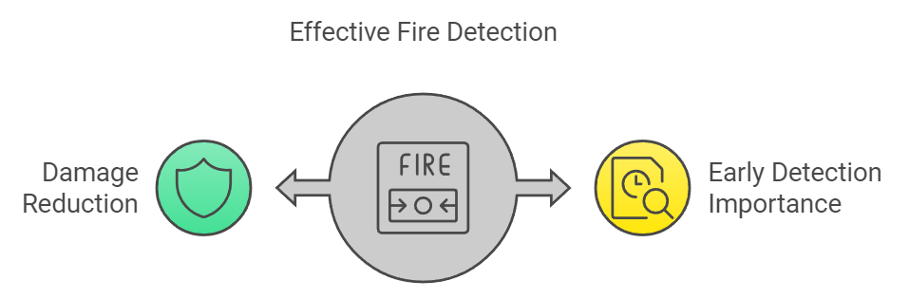
Introduction
Purpose: Overview of the growing need for effective fire detection systems.
Significance: Importance of early fire detection in reducing damage and saving trees.
Technological Integration: Utilizing deep learning techniques for enhanced fire detection.
Objective of the Presentation: Outline the implemented fire detection system.

Slide 4
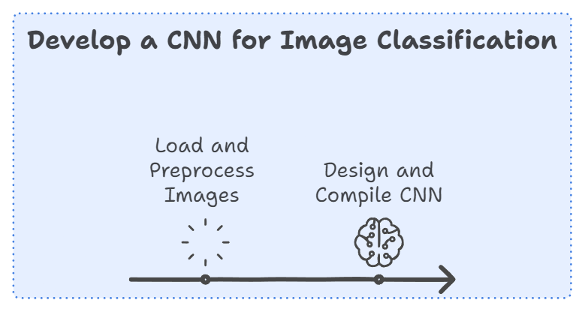
Objective
1 Data Preparation
Load Images: From specified directory.
Preprocess Data: Apply scaling and augmentations (rotation, shift, shear, zoom, flip).
2. Model Development
Design CNN: Construct layers (Convolutional, MaxPooling, Flatten, Dense).
Compile Model: Use Adam optimizer and sparse categorical cross-entropy loss.

Slide 5

Objective
3 Model Training
Train Model: Fit with augmented data, track performance metrics (accuracy, loss).
4. Model Evaluation
Evaluate Performance: Assess model on test data (loss and accuracy).
Print Metrics: Report results for model effectiveness.

Slide 6
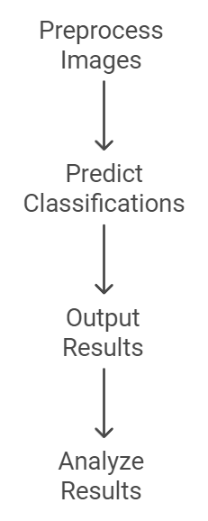
Objective
5. Image Prediction
Classify Images: Preprocess and predict new images (fire or non-fire).
Interpret Results: Output and analyze classification results.

Slide 7
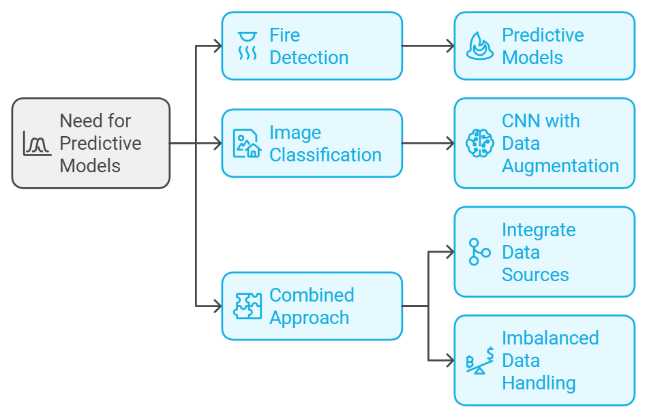
Problem Statement
Fire Detection :
Need for predictive models to estimate forest fire
Image Classification:
Classifying fire/no-fire images using CNN with data augmentation.
Combined Approach:
Integrate various data sources for a holistic view of fire risks.
Imbalanced Data Handling:
Address challenges in datasets with varying fire sizes.

Slide 8
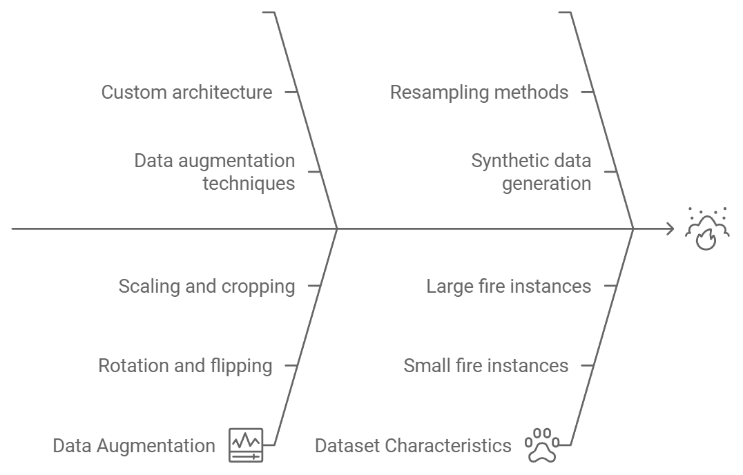
Problem Statement
Implementing a custom CNN model to enhance fire detection capabilities.
CNN for Image Data:
A custom CNN classifies fire-related images with data augmentation, improving accuracy in fire/no-fire detection.
Imbalance Mitigation:
Techniques to handle imbalanced datasets ensure accurate predictions across small and large fire instances.

Slide 9
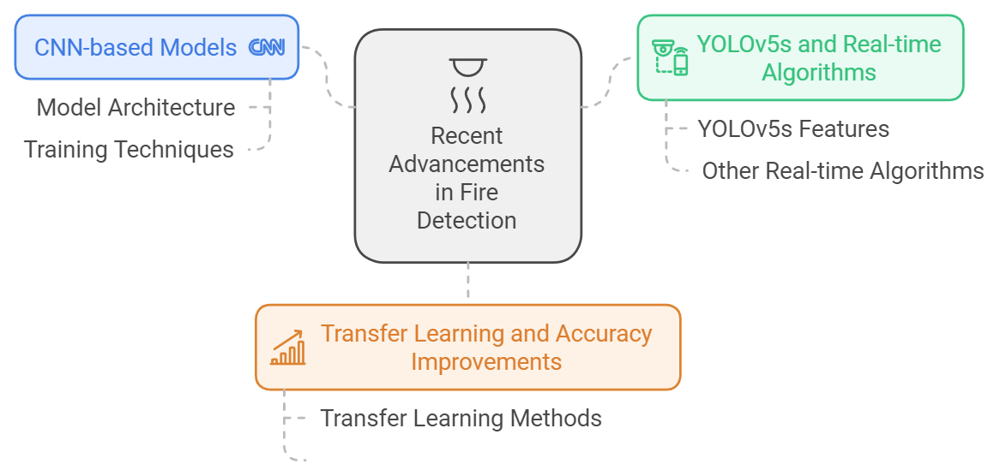
Literature Survey
Focus: Review of recent advancements and techniques in fire detection.
Key Areas:
CNN-based fire detection models.
YOLOv5s and other real-time detection algorithms.
Transfer learning and improvements in accuracy.

Slide 10
Comparative Analysis of Existing Works
Fire Detection Systems Overview:
Image-Based Detection: CNNs for improved accuracy.
Real-Time Detection: YOLOv5s improvements and results.
Technological Advances:
Enhanced YOLO Models: Accuracy and speed improvements.
Path Planning Algorithms: Integration with fire detection.
Limitations of Existing Models:
Accuracy Issues: In imbalanced datasets.
Sensor Limitations: Distance and range challenges.

Slide 11
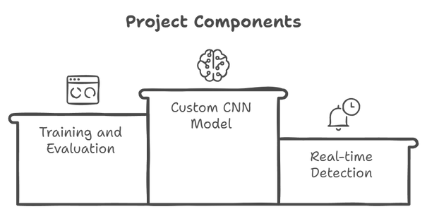
Methodology
Custom CNN Model:
Architecture details and innovations.
Advantages over existing models.
Training and Evaluation:
Dataset preparation and performance metrics.
Real-time detection and alerting mechanisms.

Slide 12
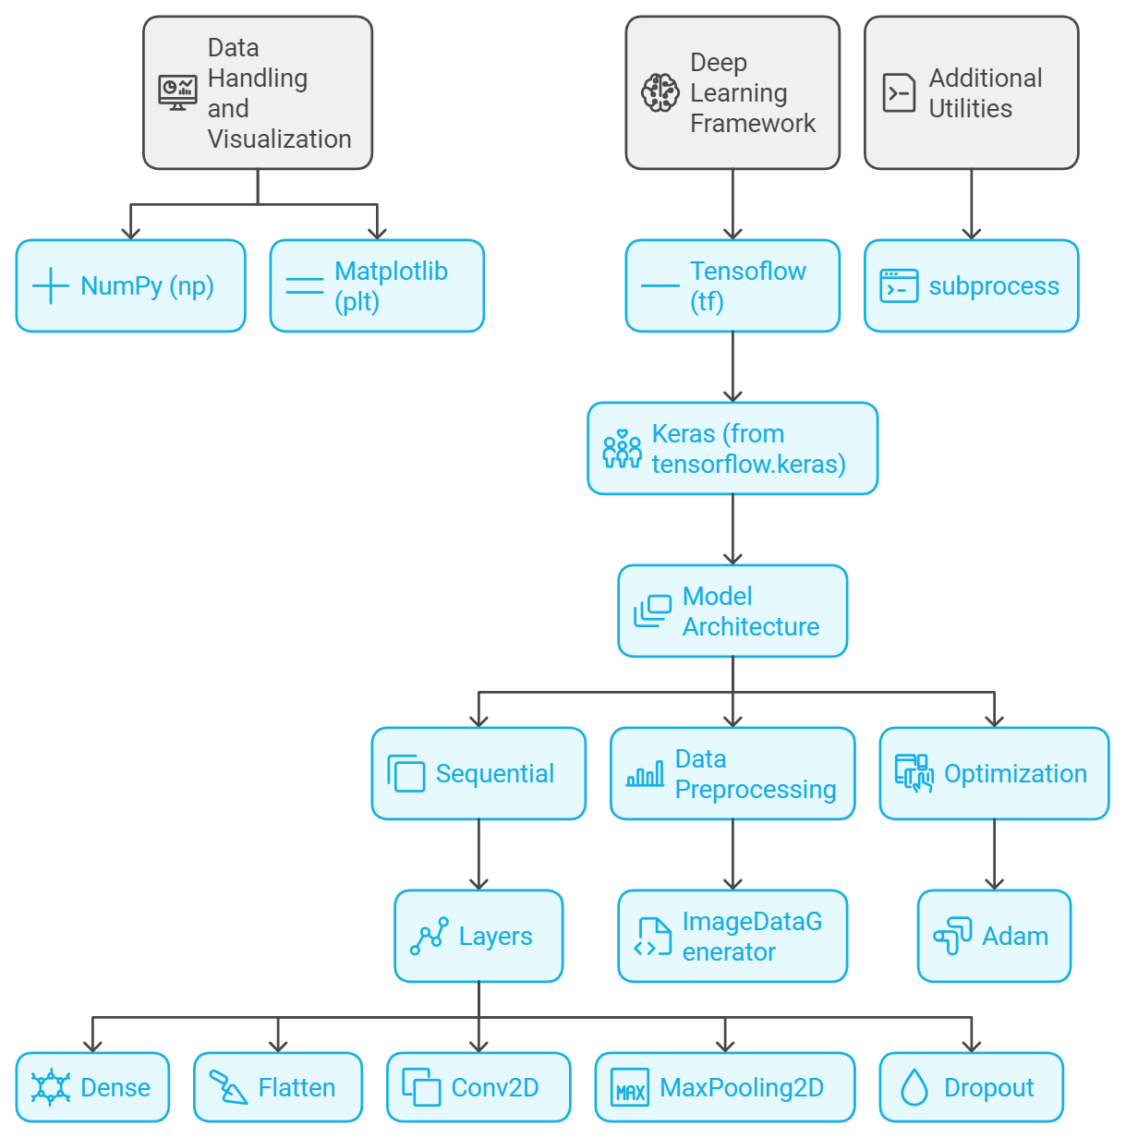
Proposed Approach
Key Libraries and Modules
Data Handling and Visualization
NumPy (np): Numerical computing with arrays
Matplotlib (plt): Data visualization and plotting
Deep Learning Framework
• TensorFlow (tf): Core library for machine learning
• Keras (from tensorflow keras): High-level neural network API
Model Architecture
Sequential: Linear stack of layers
• Layers:
Dense: Fully connected layer
Flatten: Flattens input
Conv2D: 2D convolution layer
MaxPooling2D: Max pooling operation
Dropout: Regularization technique
Data Preprocessing
• Image Data Generator: Real-time data augmentation
Optimization
• Adam: Adaptive Moment Estimation optimizer
Additional Utilities
• subprocess: Running system commands (if needed)

Slide 13
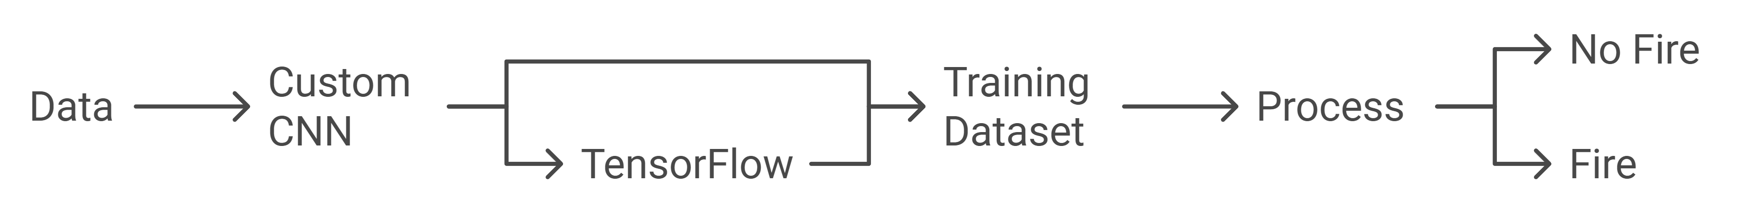
Project Design
Data →
Connected to the Custom CNN block.
Custom CNN →
Outputs to TensorFlow and also connects to the Training Dataset block.
TensorFlow →
Connects to Training Dataset, which feeds into the Process block.
Process →
Branches out into two outcomes:
No Fire
Fire

Slide 14
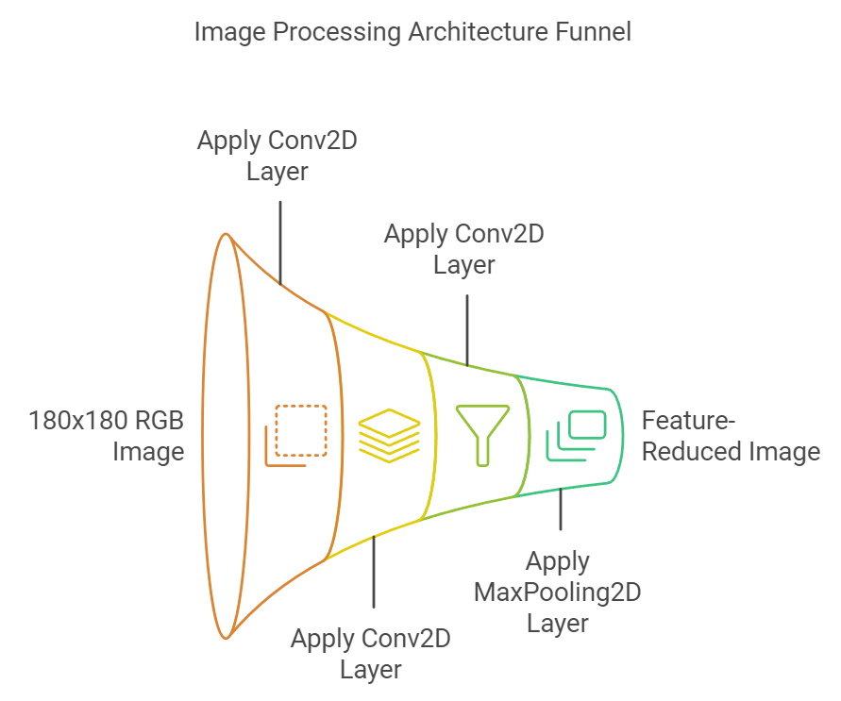
Implementation
Architecture Design
Input Layer:
Accepts 180x180 pixel RGB images (shape: 180x180x3)
Convolutional Layers:
3 Conv2D layers with increasing filters:
Layer 1: 32 filters
Layer 2: 64 filters
Layer 3: 128 filters
Each followed by Rectified Linear activation
Pooling Layers:
3 MaxPooling2D layers (2x2)
Reduces spatial dimensions, retains important features

Slide 15
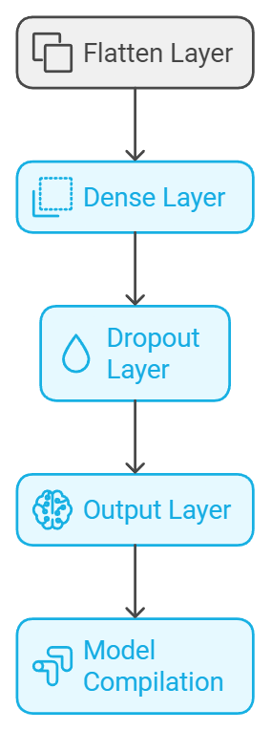
Implementation
Model Structure and Compilation
Flattening:
Flatten layer to transition from 2D to 1D
Fully Connected Layers:
Dense layer with 512 units and ReLU activation
Dropout layer (rate: 0.5) for regularization
Output Layer:
Single neuron with sigmoid activation for binary classification
Model Compilation:
Optimizer: Adam
Loss function: Binary cross-entropy
Metric: Accuracy

Slide 16
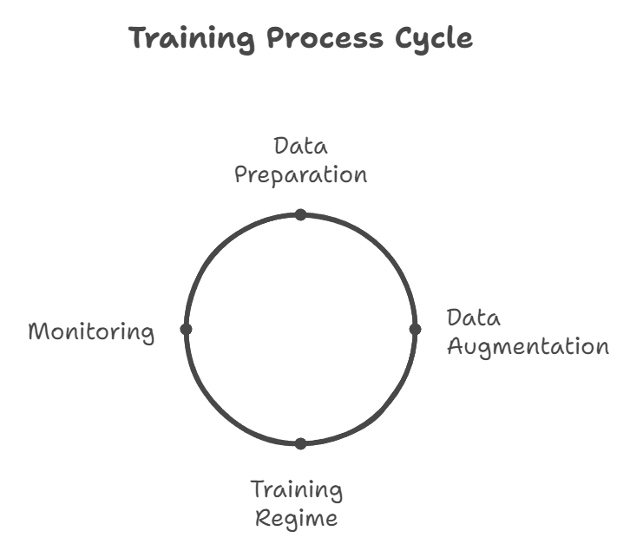
Implementation
Training Process
Data Preparation:
Resize images to 180x180 pixels
Normalize pixel values
Data Augmentation:
Apply rotation, flipping, and zooming
Increases dataset diversity and model robustness
Training Regime:
Batch training with early stopping
Validation split: 20% of data
Monitoring:
Track accuracy and loss on training and validation sets
Adjust hyperparameters as needed

Slide 17
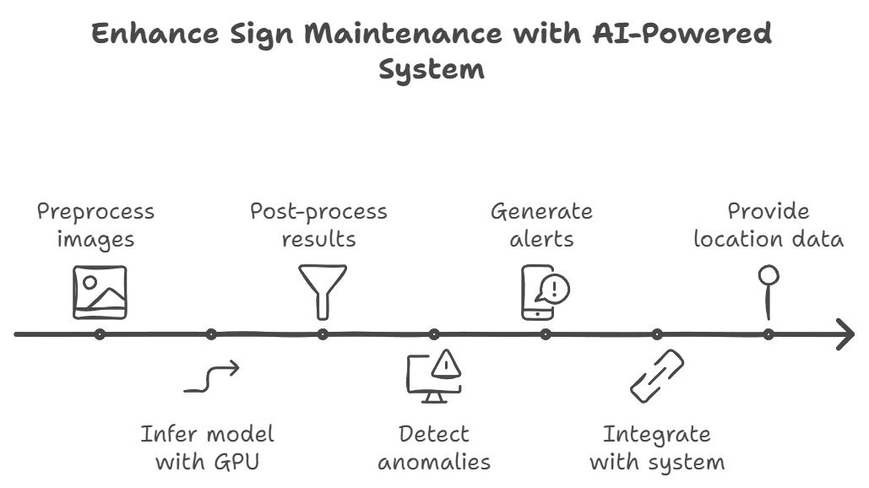
Implementation
Integration and Deployment
Inference Pipeline:
Preprocess captured images
GPU-accelerated model inference
Post-process results
Alert System:
Detect sign anomalies or damages
System Integration:
Provide data for maintenance teams

Slide 18
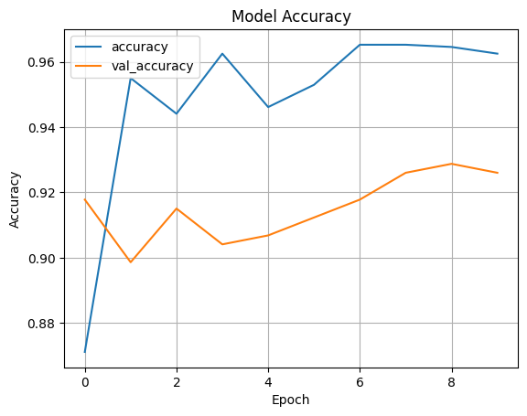
Results
Performance Metrics::
Training Accuracy: 71.88%
Validation Accuracy: 94.21%
Training Loss: 0.9540
Validation Loss: 0.1698
Epoch 10/10:
Training Accuracy: 95.90%
Validation Accuracy: 97.05%
Training Loss: 0.1281
Validation Loss: 0.0816
Sample Outputs:
Final Evaluation Metrics:
Test Accuracy: 97.16%
Test Loss: 0.0880
Image Classification Prediction:
Predicted Label: fire

Slide 19
Conclusion
Data Preparation: Utilized image data augmentation to enhance dataset diversity and model robustness.
Model Architecture: Designed a custom CNN with multiple layers for effective feature extraction from fire-related images.
Training Success: Achieved satisfactory accuracy during validation, indicating potential for real-world applications.
Prediction & Alerts: Integrated an automated email alert system for immediate notification upon fire detection.
Future Enhancements: Opportunities for real-time monitoring, mobile support, and collaboration with fire safety agencies to improve effectiveness.

Slide 20
Future Plan
Model Enhancements
Explore Transfer Learning and advanced architectures for improved accuracy.
Real-Time Fire Detection
Develop a system for live monitoring using IoT for immediate alerts.
Mobile Application Development
Create a user-friendly app for real-time fire alerts and visualizations.
Data Augmentation and Diversity
Implement advanced techniques to enhance model robustness.
Collaboration with Agencies
Partner with organizations to validate the model and improve data collection.

Slide 21
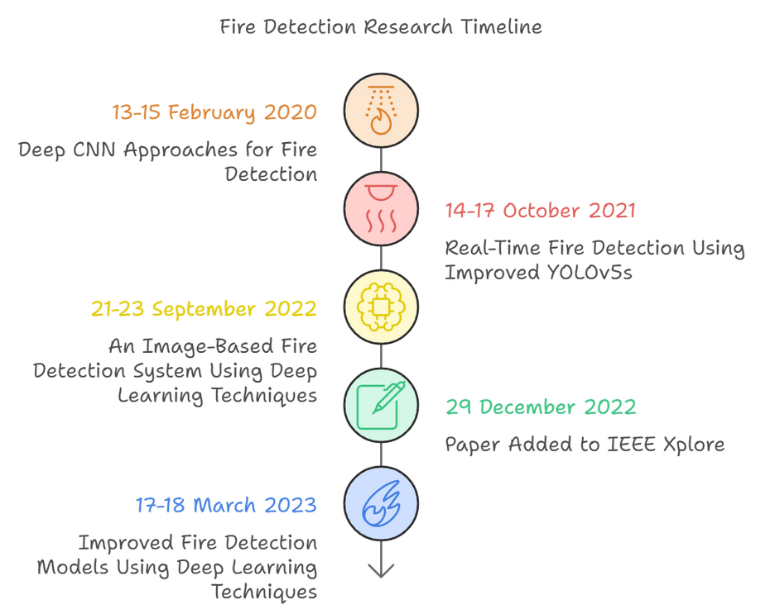
References
Real-Time Fire Detection Using Improved YOLOv5s
Authors: Jianchen Miao; Guangyuan Zhao; Yue Gao; YinzheWen
DOI: 10.1109/ICCAIS52680.2021.9624619
Conference: ICCAIS 2021
Date: 14-17 October 2021
Location: Xi'an, China
Improved Fire Detection Models Using Deep Learning Techniques
Authors: P. Nagababu; K. Dhakshitha; G. Chandrika; U. Rohith Chowdary
DOI: 10.1109/ICACCS57279.2023.10112878
Conference: ICACCS 2023
Date: 17-18 March 2023
Location: Coimbatore, India
Deep CNN Approaches for Fire Detection
Authors: Mohit Dua; Mandeep Kumar; Gopal Singh Charan; Parre Sagar Ravi
DOI: 10.1109/I4Tech48345.2020.9102697
Conference: I4Tech 2020
Date: 13-15 February 2020
Location: Pune, India

Slide 22
Thank you very much!

